Slide 1

P4 Programmable Data Plane Switches
Joseph Telaak, Elie Kfoury, Jose Gomez, Ali AlSabeh, Shararin Sharif, Jorge Crichigno, PhD.

Slide 2
Traditional Switching
Hubs
Layer 1 (Physical)
Forwards everything everywhere
Relies on packet dropping
Slow
Can cause DOS on large networks
Unmanaged switches
(Layer 2 Data-Link)
Forwards based on MAC
Popular to just add more ports
Managed Switches
Layer 2 with Layer 3 (Network) functionality
Operates very similarly to unmanaged
Has added configurability & security
Can do some routing (VLANs)
Modify control plane but not data plane
Best for buildings and datacenters

Slide 3

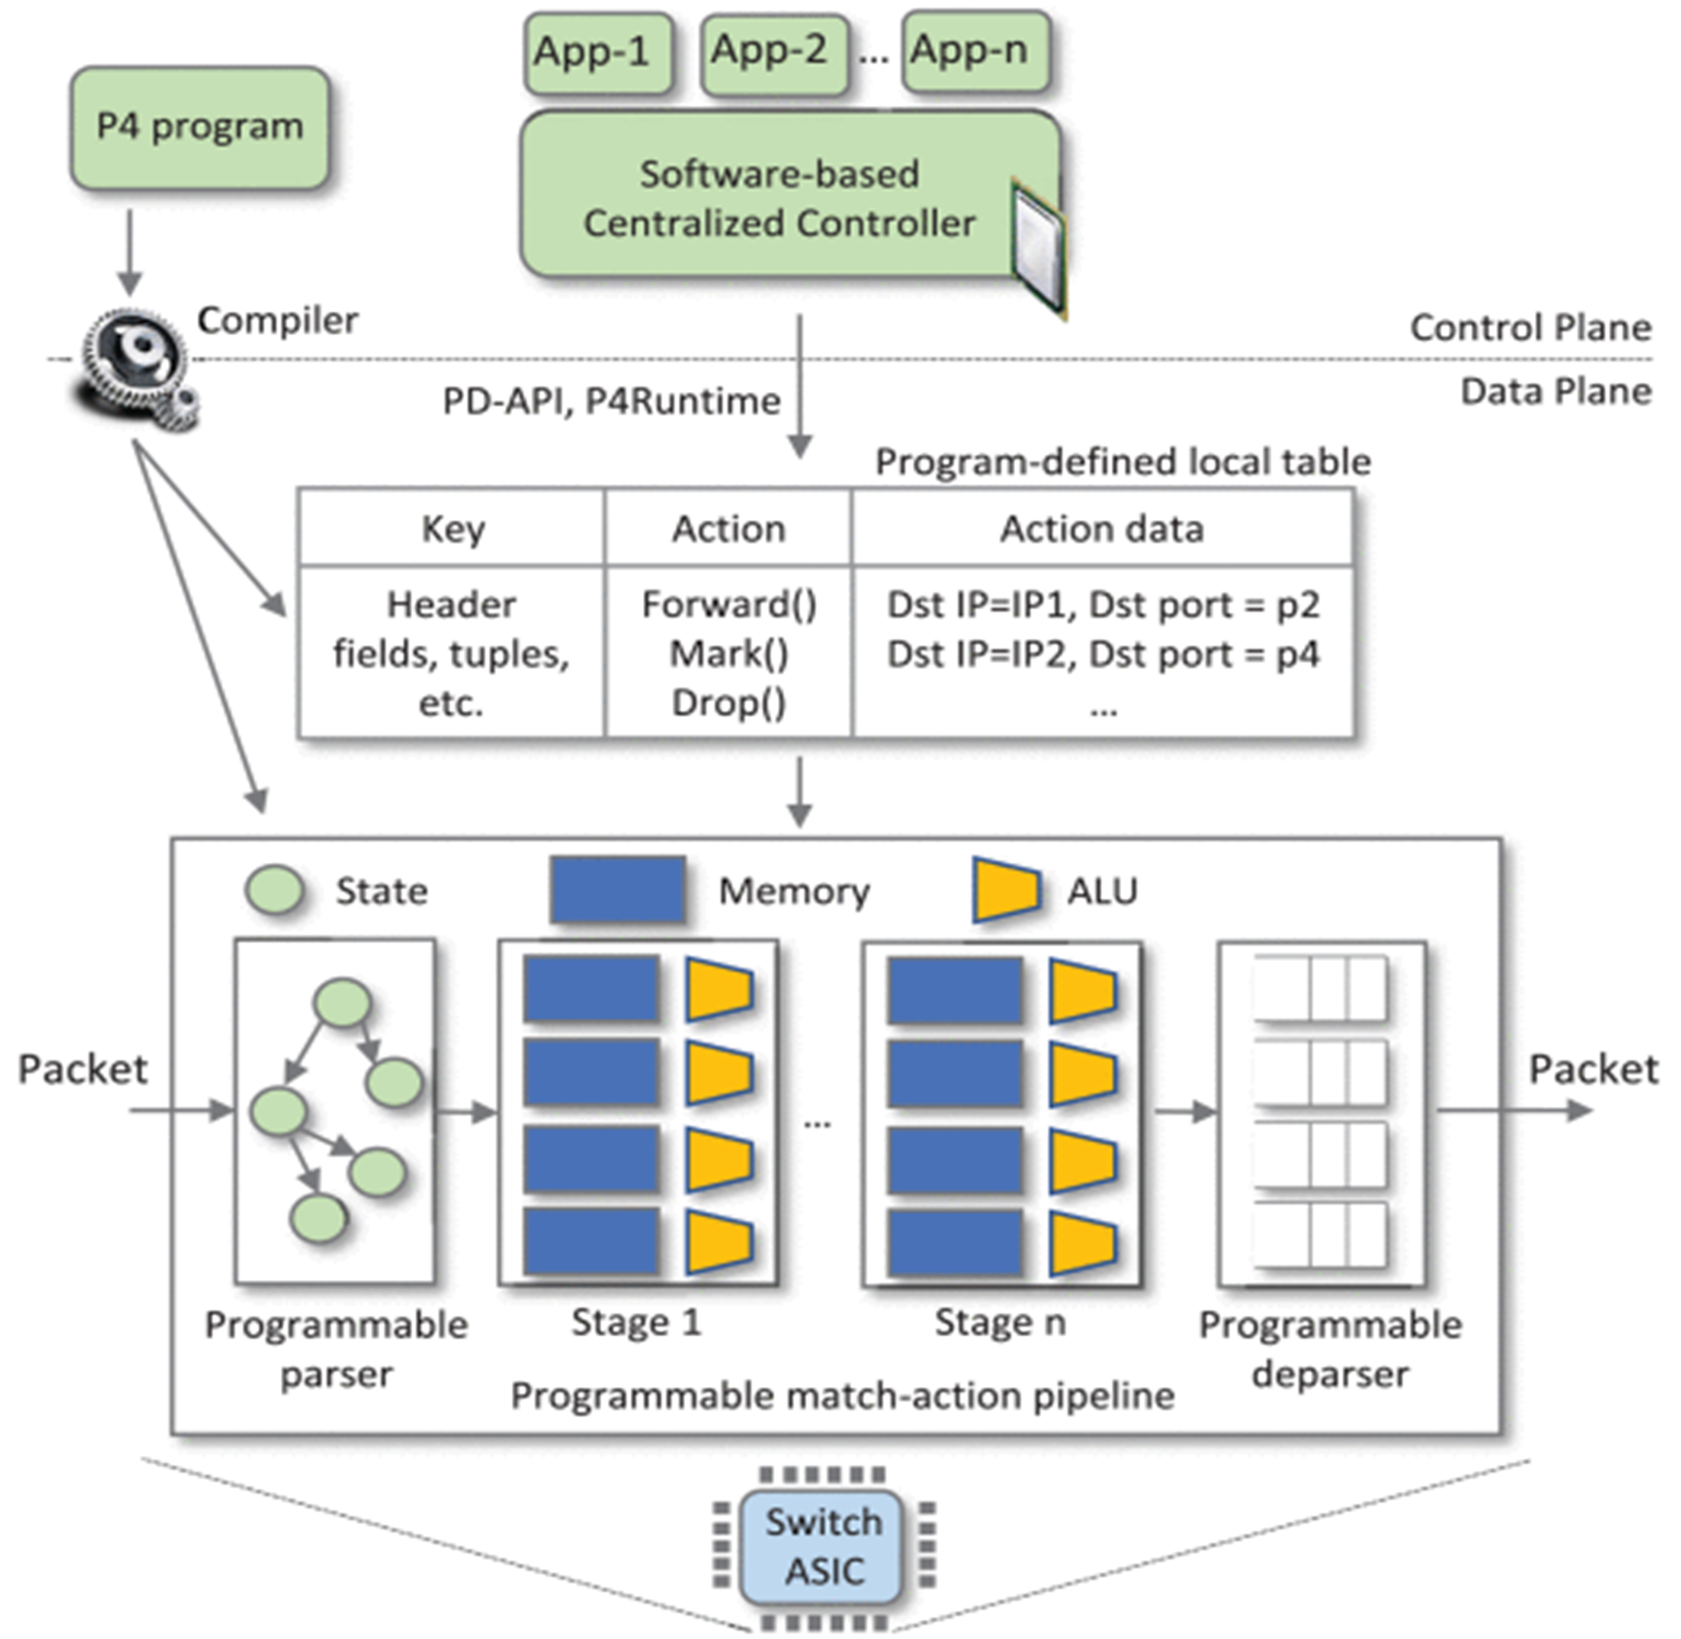
Control & Data Plane
Control Plane
Defines logic to determine how packets are switched by the data plane
Independent of Data Plane
Contains routing table
Applications like QoS
Protocols like BGP, OSPF, IS-IS
Data Plane
Functions & Processes for packet switching
Parser & De-parser
E. F. Kfoury, J. Crichigno and E. Bou-Harb, "An Exhaustive Survey on P4 Programmable Data Plane Switches: Taxonomy, Applications, Challenges, and Future Trends," in IEEE Access, vol. 9, pp. 87094-87155, 2021, doi: 10.1109/ACCESS.2021.3086704.

Slide 4

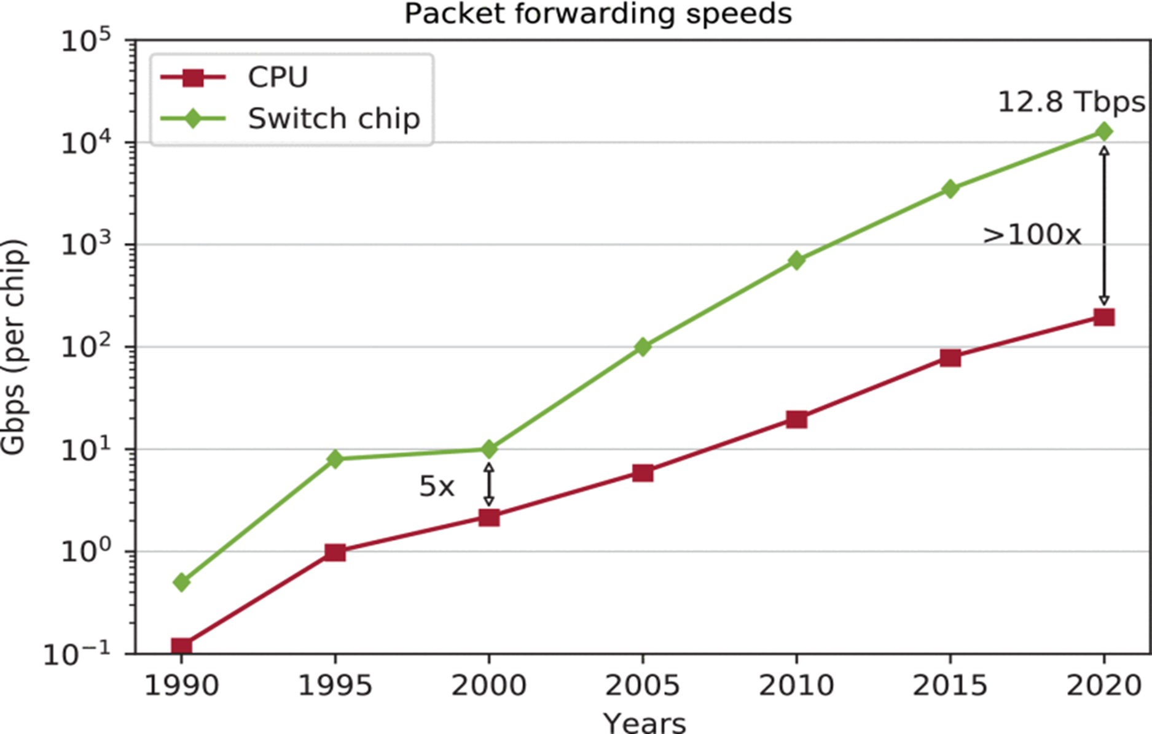
P4
(Programming Protocol-Independent Packet Processors)
Programming language developed in 2014
Target-Independent (CPU & ASICs)
ASICs are significantly faster
No native protocol support
Everything defined by programmer
Allows researchers to develop protocols faster
Feature rollout from vendors takes years
E. F. Kfoury, J. Crichigno and E. Bou-Harb, "An Exhaustive Survey on P4 Programmable Data Plane Switches: Taxonomy, Applications, Challenges, and Future Trends," in IEEE Access, vol. 9, pp. 87094-87155, 2021, doi: 10.1109/ACCESS.2021.3086704.

Slide 5
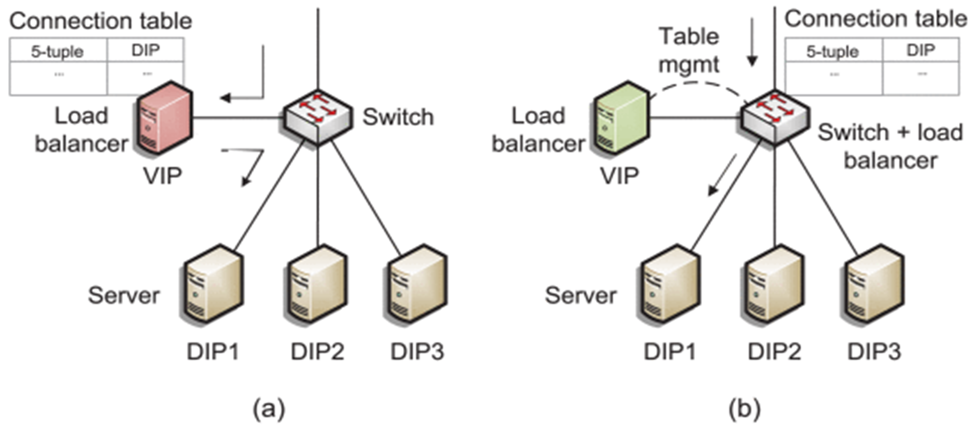
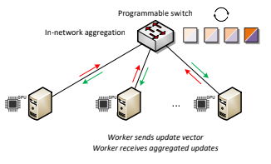
Applications
In-Band Network Telemetry
Add metadata in transit
Adjust sending rates to reduce congestion
Load Balancing
Do forwarding on the switch and manage table on a server
Instead of forwarding from the server
Machine Learning
Aggregate data on switch instead of on workers (Aggregation is cheap)
E. F. Kfoury, J. Crichigno and E. Bou-Harb, "An Exhaustive Survey on P4 Programmable Data Plane Switches: Taxonomy, Applications, Challenges, and Future Trends," in IEEE Access, vol. 9, pp. 87094-87155, 2021, doi: 10.1109/ACCESS.2021.3086704.

